Slide 1
Pizzaa shop sales
Data Analysis

Slide 2
Project Objective
The aim of this project is to analyze pizza sales data to uncover actionable business insights, such as identifying best-selling pizzas, optimizing staffing based on peak hours, and understanding customer preferences. This information can guide marketing efforts, inventory planning, and operational improvements.

Slide 3
Dataset Description
The dataset consists of several interrelated tables typically including:
Orders (orders): Order ID, customer ID, order date/time, order status
Order Details (order_details): Order detail ID, order ID, pizza ID, quantity
Pizzas (pizzas): Pizza ID, name, size, price, category (vegetarian, meat, etc.)
Customers (customers): Customer ID, name, email, location (optional)
Employees (employees): Employee ID, name, role (e.g., cashier, delivery)
Store Info (stores): Store ID, location, region (if multiple locations)

Slide 4
Key Analyses Performed
Sales Analysis
Total revenue, average order value, and number of orders
Sales trends over days, weeks, and months
Pizza sales by size and category
Menu Performance
Best- and worst-selling pizzas
Profit margin by pizza (if cost is available)
Average quantity sold per pizza per day
Customer Insights
Most frequent customers
Customer order frequency and patterns
Popular pizza types by time of day/week
Operational Optimization
Peak hours and days of the week for sales
Employee sales performance (if tracked)
Location-based comparisons (if multi-store)

Slide 5
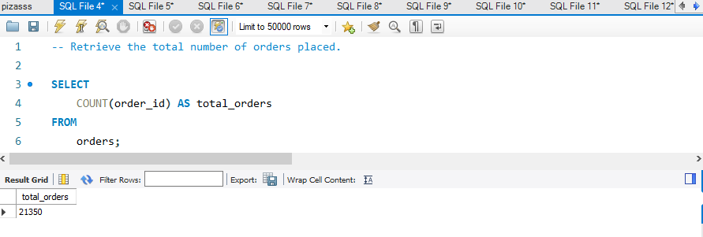
Retrieve the total number of orders placed.

Slide 6
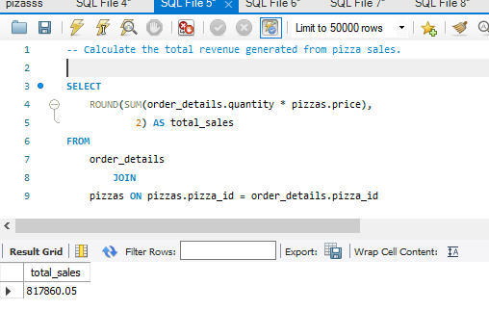
Calculate the total revenue generated from pizza sales.

Slide 7
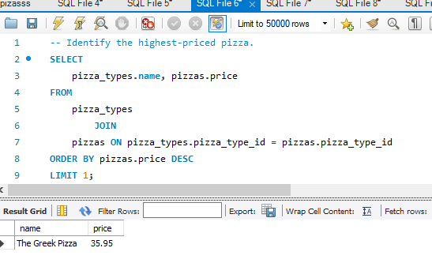
Identify the highest-priced pizza.

Slide 8
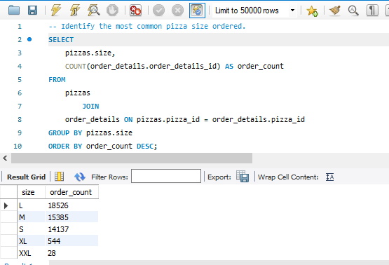
Identify the most common pizza size ordered.

Slide 9
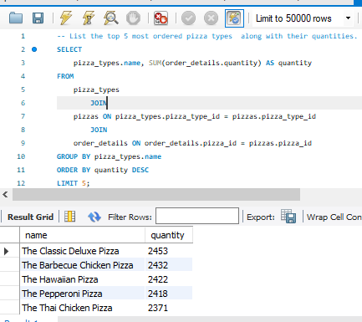
List the top 5 most ordered pizza types along with their quantities.

Slide 10
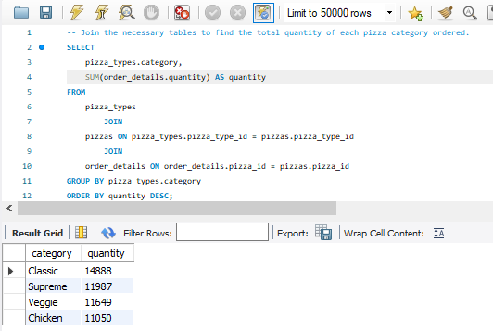
Join the necessary tables to find the total quantity of each pizza category ordered.

Slide 11
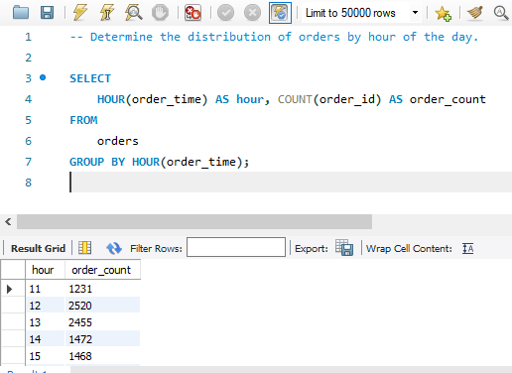
Determine the distribution of orders by hour of the day.

Slide 12
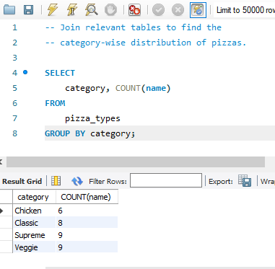
Join relevant tables to find the category-wise distribution of pizzas.

Slide 13
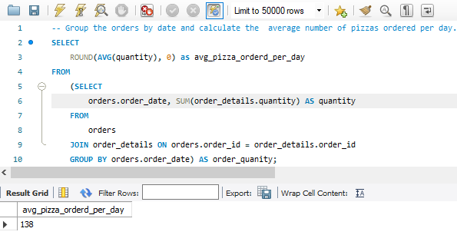
Group the orders by date and calculate the average number of pizzas ordered per day.

Slide 14
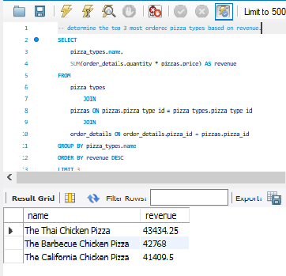
Determine the top 3 most ordered pizza types based on revenue.

Slide 15
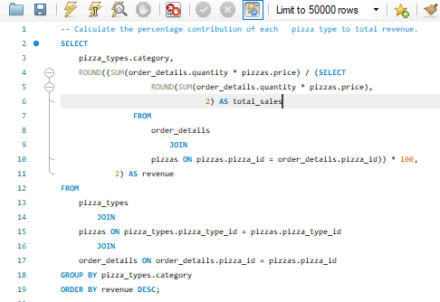
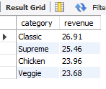
Calculate the percentage contribution of each pizza type to total revenue.

Slide 16
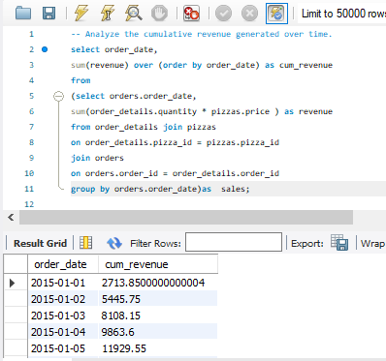
Analyze the cumulative revenue generated over time.

Slide 17
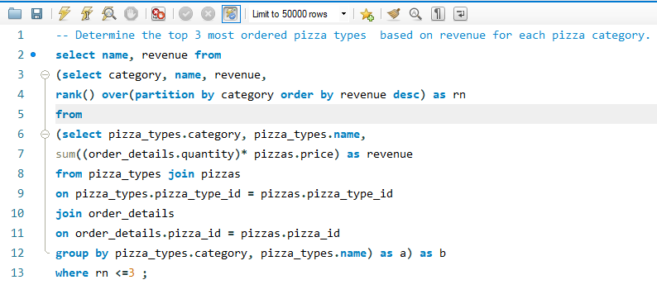
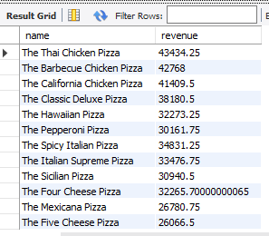
Determine the top 3 most ordered pizza types based on revenue for each pizza category.

Slide 18
Conclusion:
This SQL project not only serves as a robust data management system but also as a strategic tool for business intelligence. By maintaining comprehensive data on every aspect of the store’s operations, the database allows store managers to make precise adjustments to improve both customer experience and profitability. This project can provide practical insights into how structured SQL queries can be used to harness data for real business applications, making it an excellent resource for aspiring data analysts and business owners alike.

